Slide 1


Department of Computer Science and Engineering
Smart Glass for Visually Impaired Person
Dr.R.Sabitha.,Ph.D
Professor of Computer Science and Engineering
B21A2425C35
Rathi Devi J – 210701506
Jegan G - 210701521

Slide 2
Problem Statement and Motivation
Visually impaired individuals face significant challenges in navigating unfamiliar environments safely and independently. Existing navigation tools often lack integration with specialized aids and real-time feedback systems. The Smart Glass for Visually Impaired person aims to develop a mobile application integrated with smart specs equipped with GPS, ultrasonic sensors, a camera, and a hearing device.

Slide 3
Objectives
1.Develop a Smart Glasses Prototype:
Design and build a pair of smart glasses incorporating GPS, ultrasonic sensors, a camera, and a hearing device.
2.Create a Mobile Application:
Develop a user-friendly mobile application that communicates with the smart glasses.
3.Integrate Navigation Features:
Utilize GPS for accurate outdoor location tracking and route guidance.
4.Enhance Environmental Recognition:
Use the camera to identify and provide information about objects and landmarks.

Slide 4
Abstract
This project focuses on developing a "Smart Glass for Visually Impaired Persons" that enhances mobility and safety through advanced technology. The smart glass features an ultrasonic sensor for obstacle detection, a camera for emergencies, a microcontroller for processing inputs, and a GPS module for real-time location tracking. In emergency situations, the smart glass captures live video and sends it along with the user's location to pre-configured emergency contacts via Bluetooth through a mobile app. The app also provides a user-friendly interface for managing contacts and settings. A key feature of this system is its ability to differentiate between new and familiar locations: when visiting a new place, the smart glass automatically sends an alert message, live location, and video to emergency contacts, whereas in frequently visited places, these alerts are not sent, reducing unnecessary notifications.

Slide 5
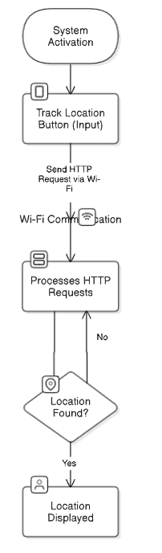
System Architecture

Slide 6
List of Modules
1. IoT-Based Location Tracking Module Functions:
Fetches GPS location data from the mobile phone. Sends location data to the NodeMCU (ESP8266) via HTTP communication. Processes requests from the third-party user.
Key Components: Mobile GPS, NodeMCU (ESP8266), HTTP Communication.
2. Mobile Application Interface Module Functions: Provides a user-friendly interface for third-party users to request the blind person’s location. Displays the retrieved location on the map. Handles reprocessing requests if the location is not found.
Key Components: Mobile app interface (buttons, maps), HTTP client, error-handling logic.

Slide 7
List of Modules
3. Data Communication and Reprocessing ModuleFunctions:
Ensures reliable data transfer between the mobile app and NodeMCU using Wi-Fi.Handles errors and retries requests if location data retrieval fails.
Key Components: ESP8266 Wi-Fi communication, error detection logic, reprocessing functionality.

Slide 8
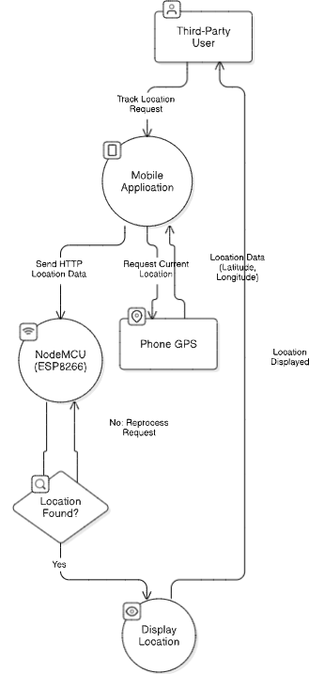
Functional Description for each modules with DFD and Activity Diagram

Slide 9
Implementation & Results of First Module
Hardware Setup:
NodeMCU (ESP8266) is used as the microcontroller to handle communication and processing.
GPS Module (e.g., NEO-6M) is connected to the NodeMCU to fetch the location (latitude and longitude) of the user.
Mobile Phone (with GPS) is used by the third-party user to request the location of the blind person via the mobile application.
Wi-Fi Module (ESP8266) is responsible for communication between the mobile app and the NodeMCU.

Slide 10
Implementation & Results of First Module
GPS Data Collection:
The NodeMCU retrieves the location (latitude and longitude) from the GPS Module.GPS Module provides real-time location data to the NodeMCU.
Location Validation:
The NodeMCU verifies if the GPS data (latitude and longitude) is valid (if the data is not 0.0 or missing).
If the location is found, the NodeMCU sends the valid GPS data back to the Mobile Application via Wi-Fi.
If the location is not found, the NodeMCU triggers a retry or sends a reprocessing message to the mobile app.

Slide 11
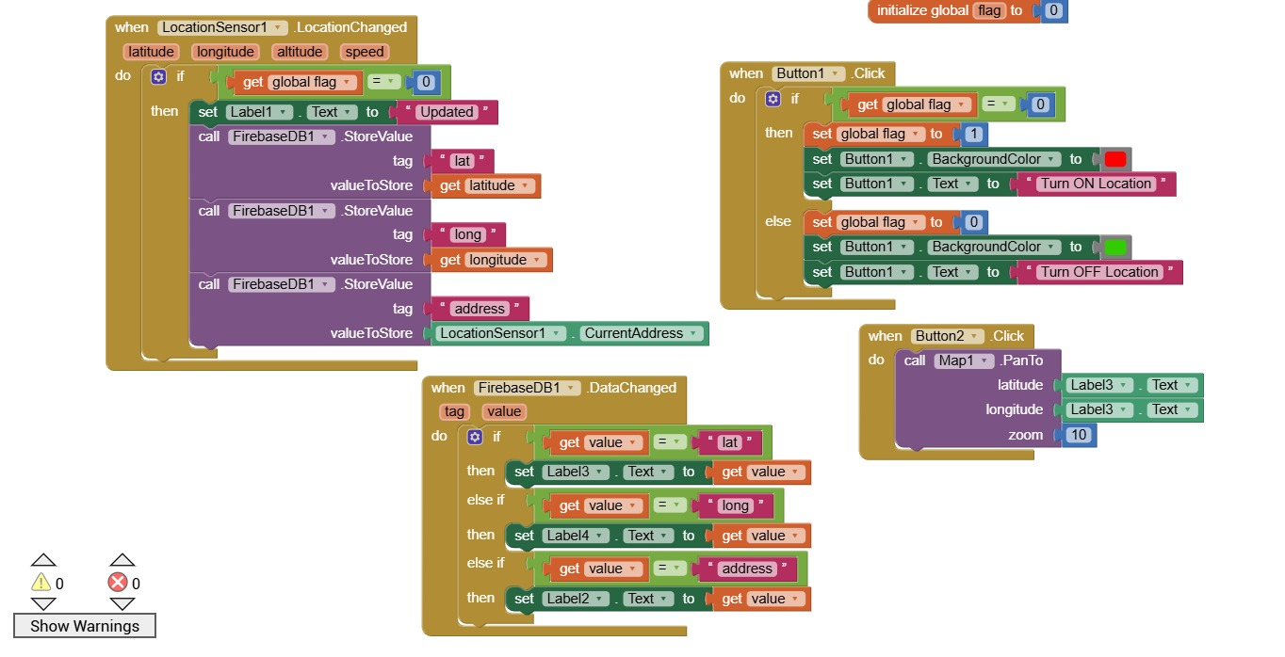
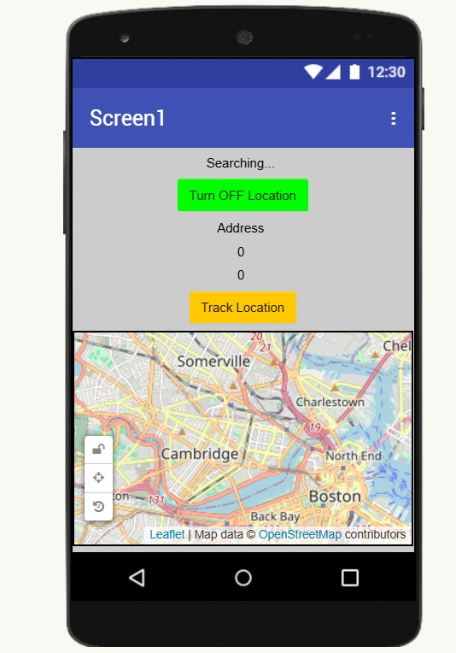
OUTPUT SCREENSHOTS

Slide 12
Conclusion & Work for Phase II
Conclusion:
The Location Tracking System for Blind Navigation combines a mobile app and NodeMCU (ESP8266) to assist visually impaired individuals. The system allows third-party users to track the blind person’s location in real time, providing guidance through the mobile app. By using the mobile phone's GPS data, the system ensures accurate location tracking and updates. This solution enhances mobility, safety, and independence for blind individuals, helping prevent disorientation and accidents. The project demonstrates the potential of mobile and IoT technologies to solve real-world challenges, and future improvements can expand its capabilities for even better support and safety.
Future Work:
Integrate more advanced machine learning models for improved object detection.
Develop a mobile application to streamline emergency alerts.

Slide 13
References
[1] Mukhiddinov, Mukhriddin, and Jinsoo Cho. "Smart glass system using deep learning for the blind and visually impaired." Electronics 10.22 (2021): 2756.
[2] Nandyal, Suvarna, Prajita R. Udgiri, and Sakshi Sherikar. "Smart Glasses for Visually Impaired Person." Journal of Scientific Research and Technology (2023): 21-31.
[3] Srividya, K., et al. "Smart Glasses for Disabled People." 2023 Intelligent Computing and Control for Engineering and Business Systems (ICCEBS). IEEE, 2023.
[4] Abayomi, Rotimi. "Design and Implementation of Smart Glasses for Blind People." (2022).
[5] Kumar, D. Ravi, et al. "Object detection system for visually impaired persons using smartphone." ICDSMLA 2020: Proceedings of the 2nd International Conference on Data Science, Machine Learning and Applications. Springer Singapore, 2022.

Slide 14
Paper Publication Status
TITLE : SMART GLASS FOR VISUALLY IMPAIRED
PERSON
AUTHORS : Dr. Sabitha R , Rathi Devi J , Jegan G
MODE OF PUBLICATION: Online
CONFERENCE : International Conference on Computer,
Communication and Signal Processing
[ICCCSP 2025]
PUBLICATION STATUS : Submitted for the conference

Slide 15
Thank You

